Slide 1

FinSight AI: Automated Financial Close & Compliance
A Final Year Project Proposal for Fall 2025
Department of CS, Fast School of Computing
FAST - NUCES, Karachi Campus.

Slide 2
Group Members
Mishkaat Yousuf
22K-4624
Ayesha Ansari
22K-4453
M. Fahad
22K-5001
1
2

Slide 3

Project Abstract: Revolutionizing Financial Close
The financial close process is critical but often manual, time-consuming, and error-prone, especially in Pakistan. Inefficiencies lead to delayed reporting, fraud risks, and non-compliance with IFRS, SBP, and FBR regulations.
The Problem
The Solution
Key Outcomes
Manual, error-prone financial close processes in Pakistan.
FinSight AI: an agentic AI-powered assistant to automate month-end financial close.
Reduced cycle time, improved accuracy, real-time anomaly detection.

Slide 4

Introduction: The Need for AI in Finance
Financial close processes are critical but remain highly manual and error-prone in Pakistan. Global firms leverage AI for efficiency, yet local adoption is minimal despite increasing regulatory demands.
Current Challenges
FinSight AI's Approach
Manual, repetitive, and error-prone workflows.
Agentic AI for automated month-end close.
Reliance on Excel and partially automated ERPs.
Specialized agents for accruals, reconciliations, and compliance.
Delayed reports, fraud risks, and weak regulatory oversight.
NLP, anomaly detection, and rule-based validation.

Slide 5

Project Rationale & Objectives
FinSight AI addresses inefficiencies in Pakistan's finance sector, aiming to reduce human error, improve compliance, and enhance transparency.
Aims
Objectives
To design and develop an AI-driven, agentic financial assistant that automates the month-end financial closing and compliance process.
01
Automate Core Tasks
Accruals, adjustments, and reconciliations.
02
Ensure Compliance
With IFRS, SBP, and tax rules.
03
Detect Anomalies
Identify fraud in real-time.
04
Provide Insights
Narrative summaries and dashboards.

Slide 6
Success Criteria: Measuring Impact
The success of FinSight AI hinges on its ability to automate critical tasks and ensure compliance, with measurable criteria for evaluation.
1
2
Automation of Core Tasks
Accuracy & Compliance
Successfully automate at least three key financial close activities.
Achieve high accuracy in reconciliations and flag all policy violations.
3
4
Efficiency Improvement
Anomaly Detection
Reduce the financial close cycle time significantly.
Correctly identify unusual or suspicious transactions.
5
6
Decision-Support Outputs
Audit Trail & Transparency
Generate clear, usable narrative summaries and dashboards.
Log all system and user actions in an immutable audit trail.

Slide 7


Key Features & Benefits
Recent literature highlights the importance of automation and AI in streamlining accounting workflows, with global firms already adopting AI-driven solutions.
Automated Financial Close
Real-time Anomaly Detection
Reduces month-end cycle time
AI-powered fraud detection and compliance monitoring
Multi-Agent Architecture
Regulatory Compliance
Specialized agents for different financial tasks
Automated IFRS, SBP, and FBR compliance checking
These features collectively position FinSight AI as a crucial solution for Pakistani financial institutions, offering localized compliance and efficient, intelligent automation to meet their specific regulatory and operational demands.

Slide 8

Literature Review: AI in Financial Automation
Foundational Research
Methodology | Strengths | Weaknesses / Gaps
Usman Rasheed & Co – Key Challenges in Maintaining Accurate Financial Records in Pakistan (manual/outdated accounting practices). | Identifies reliance on outdated/manual systems causing inefficiencies and delays. | Focuses only on challenges; does not propose technological or AI-based solutions.

Slide 9
Literature Review: AI in Financial Automation
Multi-Agent Systems in Finance
Methodology | Strengths | Weaknesses / Gaps
Joshi, Satvadhar (AI multi-agent frameworks). | Demonstrates how AI agents enable autonomous decision-making, risk assessment, fraud detection, and compliance automation. | Research mainly global; few localized implementations in Pakistan or South Asia.

Slide 10
Literature Review: AI in Financial Automation
Regional Context & Gap Analysis
Methodology | Strengths | Weaknesses / Gaps
Evidence from Pakistan & global reports. | Confirms that reliance on spreadsheets/manual processes are key barriers to efficient financial close. | Research gap: very limited AI-driven, end-to-end automation for financial close in Pakistan and South Asian markets.
ACCA Pakistan Survey (2023) – Reports that 71% of businesses face cash flow problems delaying financial close. | Provides statistical evidence highlighting widespread financial reporting inefficiencies. | Survey data only; lacks discussion on automation or AI applications.

Slide 11
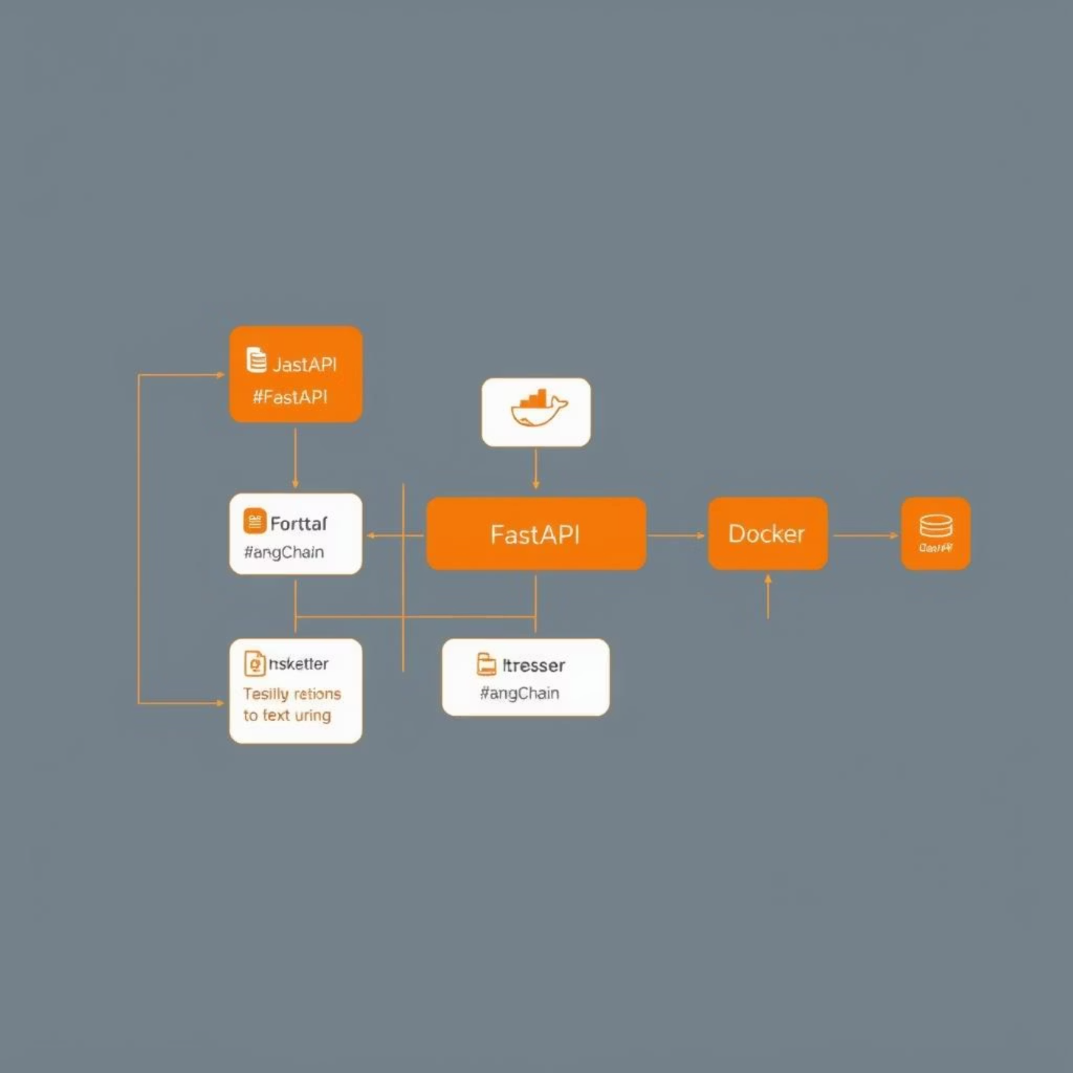
Proposed Methodology & Architecture
FinSight AI will use a monolithic architecture with a Python-based backend and specialized AI agents,
all containerized in Docker for consistent performance.
Architecture Overview
Python/FastAPI backend with RESTful API.
Specialized AI agents built with LangChain.
Containerized using Docker for consistent deployment.
Deployment Strategy
Cloudflare for public API access and security.
Portable .exe frontend for flexible user distribution.

Slide 12




Agent Communication & Workflow
Core agents will communicate via internal functions and API calls within the monolithic backend, orchestrating a streamlined financial closing process.
Document Extraction
Accruals & Adjustments
Process data from financial documents.
Validate and process financial entries.
Bank Reconciliation
Reporting
Automate balance reconciliation.
Generate dashboards and insights.
This collaborative ecosystem mimics a real-world financial closing pipeline, ensuring a cohesive and high-performance system.

Slide 13
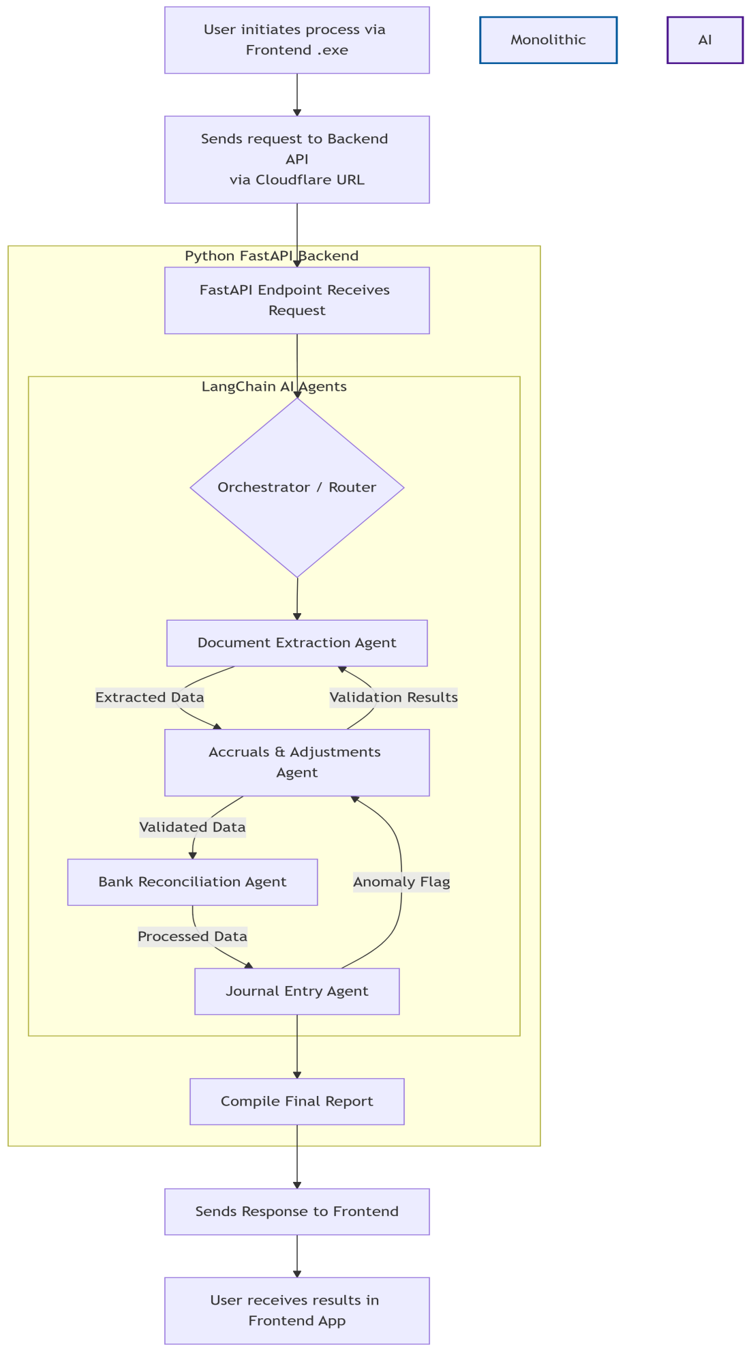

System Architecture: FinSight AI Components
Data & Integrations
PostgreSQL, Storage, Audit Logs, External APIs
AI Agents
Document, Accruals, Reconciliation, Compliance, Reporting
Orchestration
LangChain Coordinator & Task Queue
API Gateway
FastAPI, Auth & Rate Limiting
UI Layer
React Dashboard & Conversational Copilot

Slide 14
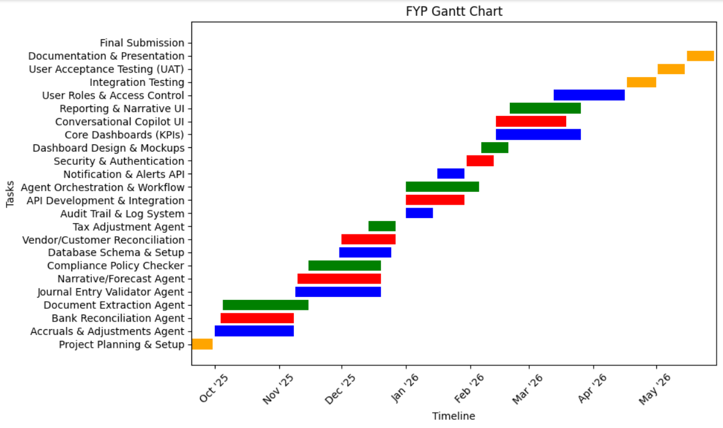
Planning & Timeline: Project Phases
The project is organized into four phases: Agent Development, Backend Development, Frontend Development, and Testing & Finalization.
Phase 1: Agent Development
1
Oct–Dec 2025: Concurrent development of multiple AI agents
And Database schema and setup
2
Phase 2: Backend Development
Jan 2026: API development, and agent orchestration.
Phase 3: Frontend Development
3
Feb–Mar 2026: Dashboard KPIs, conversational copilot, and reporting UI.
4
Phase 4: Testing & Finalization
Apr–May 2026: Integration testing, UAT, documentation, and submission.

Slide 15
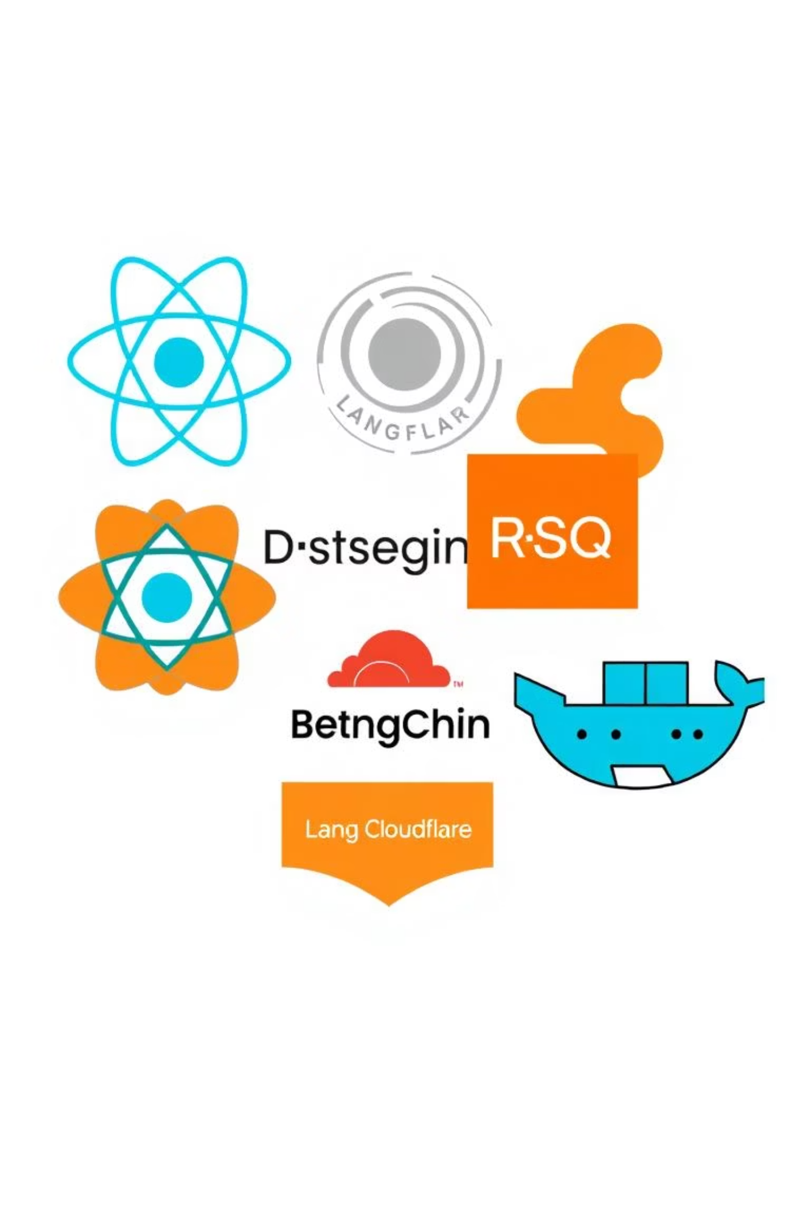




Tools & Technologies: Our Stack
FinSight AI leverages a modern, scalable, and maintainable technology stack to ensure robust performance and intuitive user experience.
Frontend
React.js, Chart.js/Plotly for interactive dashboards.
Backend
Django (Python), PostgreSQL for core logic and data.
AI & Automation
LangChain, LangGraph, NLP libraries, Tesseract OCR.
Deployment & Security
Docker, NGINX/Cloudflare for consistent deployment and security.

Slide 16
Thank You.

Slide 17
Literature Review: AI in Financial Automation
Foundational Research
Usman Rasheed & Co – Key Challenges in Maintaining Accurate Financial Records in Pakistan:
Many businesses still rely on manual and outdated accounting systems, leading to frequent errors, inefficiencies,
and delays in the financial close process.
ACCA Pakistan Survey (2023): Reports that 71% of businesses in Pakistan face cash flow problems, which
often contribute to delays in financial reporting and difficulties in timely financial close.
Multi-Agent Systems in Finance
Joshi, Satyadhar – Architectures and Challenges of AI Multi-Agent Frameworks for Financial Services: AI
multi-agent frameworks are enabling autonomous decision-making, intelligent collaboration, and the
automation of complex workflows transforming financial services through applications in risk assessment,
compliance, fraud detection, trading, and customer service.
Regional Context & Gap Analysis
Evidence from Pakistan and global reports confirms that manual processes and reliance on spreadsheets
are major barriers to efficient financial close.
Research gap: While automation has improved efficiency globally, there is limited research and deployment of AI-driven, end-to-end financial close automation in Pakistan and South Asian markets.

